Slide 1
Data Quality & Artificial Intelligence
OGC Open Standards Code Sprint
Ivana Ivánová, Curtin University
13 June 2024

Slide 2
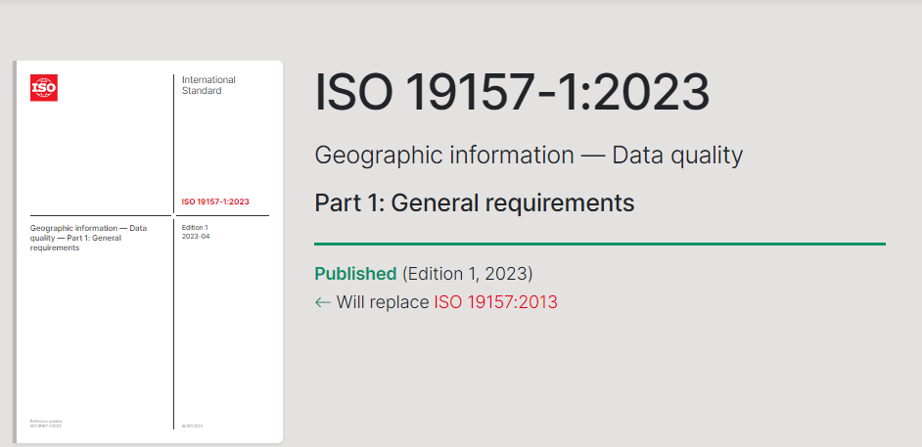
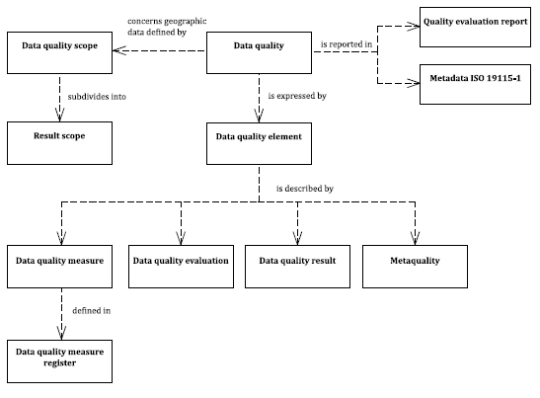
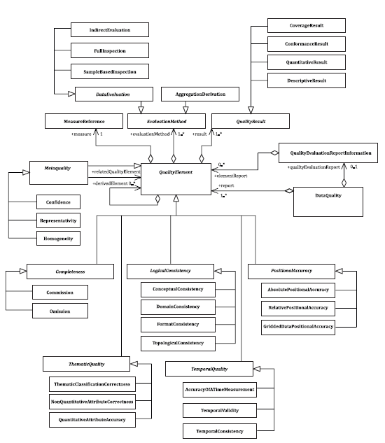
ISO/TC211 standardizes geoinfo quality

Slide 3
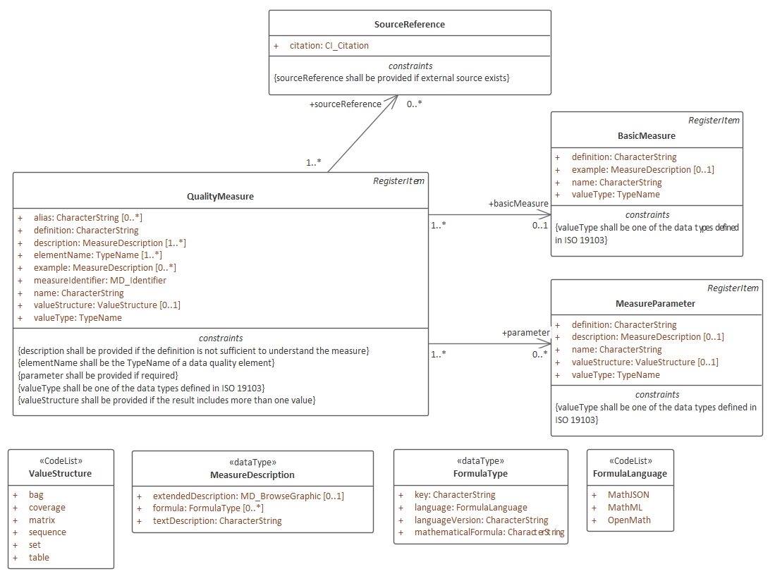
Structure of a Data Quality Measure
From ISO 19157-1:2023
Register compliant with ISO 19135, including:
Status of an item
Versioning of items
URI
… and other metadata
Notes:
Metadata: date,

Slide 4
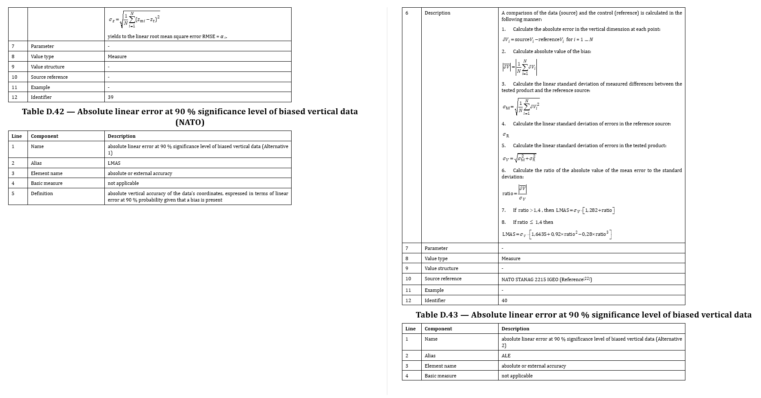
Blast from the past…
ISO 19157 Data quality measures in earlier version of the quality standard were in a normative annex typeset as tables in a PDF

Slide 5
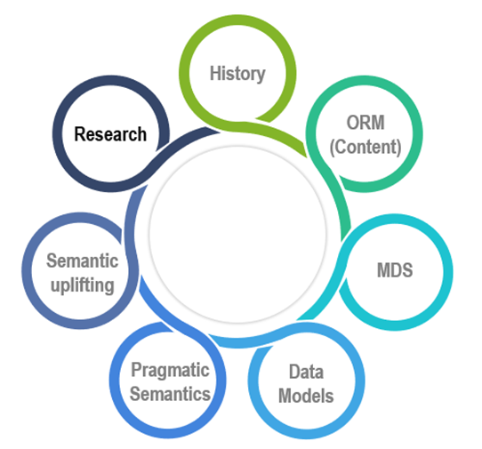
…and now
Textual part
ISO standard as pdf as usual
A reader of a standard
Register searchable at the web
ISO/AWI 19157-3 in OSD
outputs
Data Quality Measure register
OGC Rainbow server
points to
FAIR
The project work in a web format
Accessible at the web
Notes:
OSD - Online Standard Development platform, workplace for standards at the web. OSD allows writng formulas with equation editor and outputs them in MathML.
DQM in the register are compliant with the best practice for data on the web, which is assured by OGC RAINBOW server, thus making DQM FAIR (as in Findable, Accessible, Interoperable and Reusable).

Slide 6
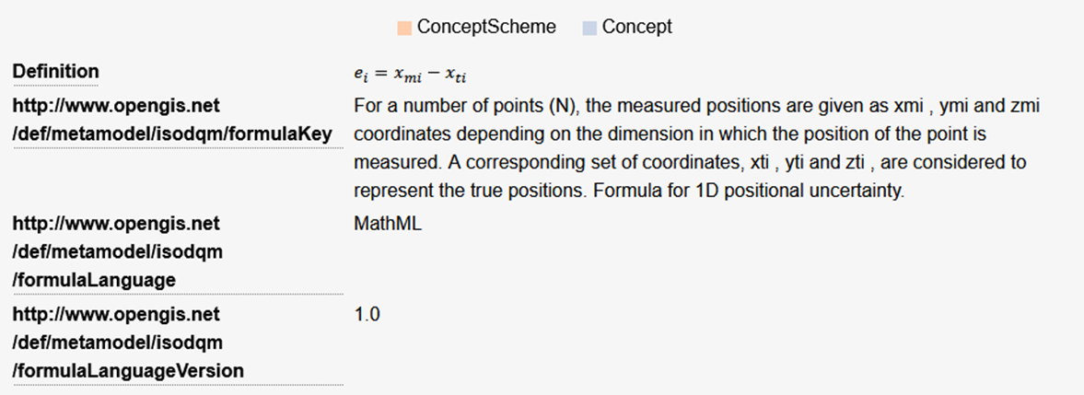
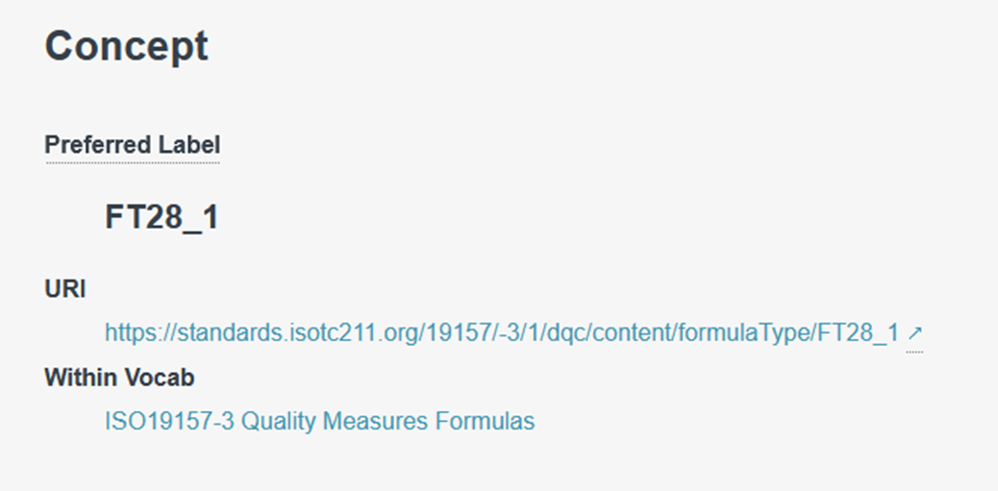
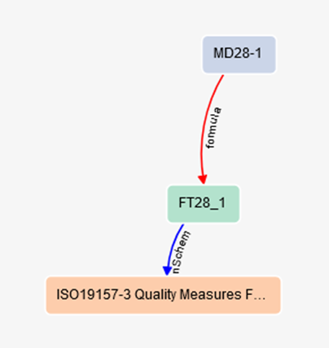
DQM – An example measure in OGC RAINBOW

Slide 7
Example in turtle form
Formula.ttl
<https://standards.isotc211.org/19157/-3/1/dqc/content/formulaType/FT28_1> a skos:Concept ;
dqm:formulaKey "For a number of points (N), the measured positions are given as xmi , ymi and zmi coordinates depending on the dimension in which the position of the point is measured. A corresponding set of coordinates, xti , yti and zti , are considered to represent the true positions. Formula for 1D positional uncertainty." ;
dqm:formulaLanguage "MathML" ;
dqm:formulaLanguageVersion "1.0" ;
skos:definition "<math xmlns=\"http://www.w3.org/1998/Math/MathML\"> <msub><mi>e</mi><mi>i</mi></msub><mo>=</mo> <mfenced close=\"|\"open=\"|\"><mrow><msub><mi>x</mi> <mrow><mi>m</mi><mi>i</mi></mrow></msub><mo>-</mo> <msub><mi>x</mi><mrow><mi>t</mi><mi>i</mi></mrow> </msub></mrow></mfenced></math>" ;
skos:inScheme <https://standards.isotc211.org/19157/-3/1/dqc/content/formulaType> ;
skos:prefLabel "FT28_1" .
Notes:
CSV – Comma Separated Values
TTL – Terse RDF Triple Language
RDF - Resource Description Framework (W3C) for semantic web

Slide 8
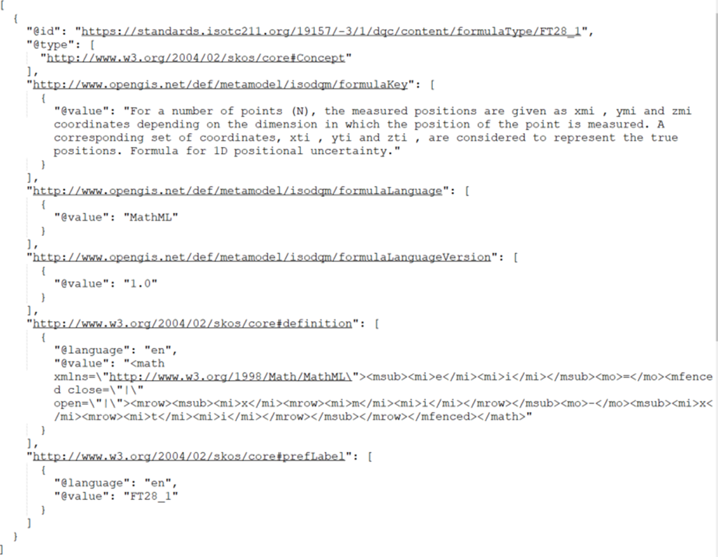
Example in JSON-LD form
Notes:
JSON-LD JavaScript Object Notation - Linked Data

Slide 9
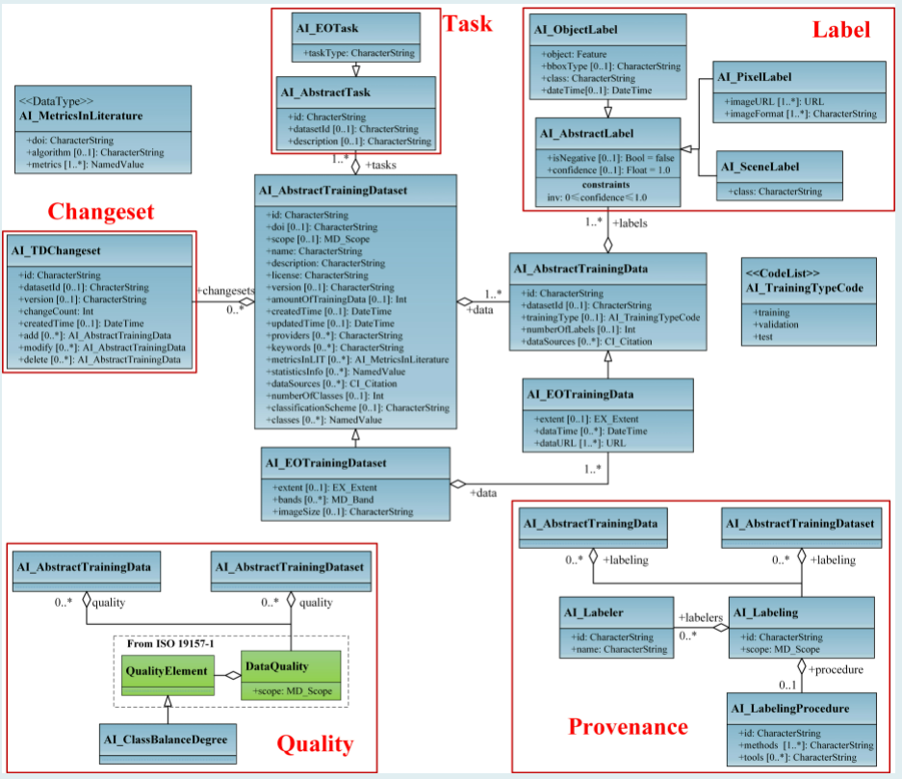
DQ and AI
OGC TrainingDML-AI
https://docs.ogc.org/is/23-008r3/23-008r3.html

Slide 10
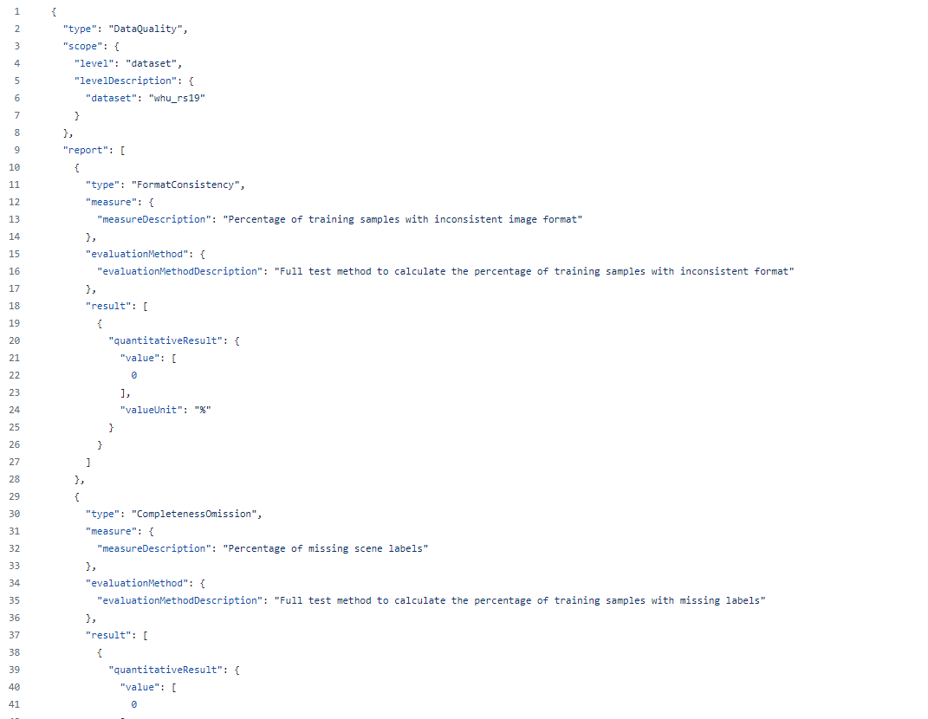
DQ and AI
https://github.com/opengeospatial/TrainingDML-AI_SWG/blob/main/use-cases/examples/1.0/WHU-RS19-quality.json
https://docs.ogc.org/is/23-008r3/23-008r3.html

Slide 11
OGC Code Sprint – goals
Test DQ Measures in the register for automatic consumption – few suggested activities:
Perform automated quality assessment using measures on the web
Document provenance of quality assessment
Reproduce quality assessment from the provenance record
Produce a training dataset for AI and assessing its quality
Perform sample reduction in a Training Dataset and record the process (incl. sampling method and other parameters) in the provenance of the result.
…
…feel free to add yours
Notes:
Hopefully we will go on with this standard
We need to have a register soon, annex D in the old standard need more measures.
OGC, Rob works with the register content
The prototype is working with the most content. But there is still a lot to do. Parallel work to the textual part, not so dependent to 19135
Control body can be like:
OGC’s Data Quality DWG. Group with focus on spatial data quality, international work with at least 20 tears. Meets 3-4 times a year.
ISPRS WG IV/II. Artificial Intelligence and uncertainty modelling
EuroGeographics Q-KEN
In the standard there is rules for how the process will be for a new measure, maybe in some webform, discussed in control body and confirmed.

Slide 12

Thank You
Community

Slide 13
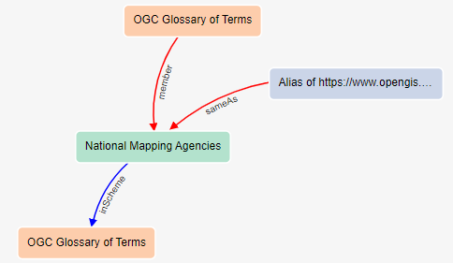
OGC RAINBOW
A Web accessible source of information about things
The “core” OGC RAINBOW can be accessed at https://www.opengis.net/def and holds definitions for terms defined by OGC example: National Mapping Agencies (preferred label) URI: http://www.opengis.net/def/glossary/term/NationalMappingAgencies
Definition
National government agencies, such as the UK's Ordnance Survey, France`s Institut Geographique National (IGN) and the US's US Geological Survey and Federal Geographic Data Committee, that are chartered to provide national mapping products and services

Slide 14
The model works as..
MD_Identifier
authority:
code: 28
codeSpace: https://ISOTC211/19157-3/-1/1/MesuereIdentifier/
Version : 2
Description:
MD28_1D-1
description:MeasureDescription
extendedDescription: - >
formula: … formulaType/FT28_1D
textDescription:
extendedDescription:MD_BrowseGraphic
fileName:
fileDescription: absolute value of a measured value in comparison to its true position
fileType: mathML/jpeg
imageConstraint: MD_Constraint (NULL)
linkage: http://ISOC211/19157-3/-1/1/ei.jpg
-
mean value of the positional uncertainties for a
- >
absolute or external accuracy
- >
ID 28-1 - >
mean value of positional uncertainties 1D
-
Real
URI: FT28_1D
formula:FormulaType
Key: m=measure, t=true value
language: mathML
languageVersion: 3.0
mathematicFormula:
<msub>
<mi>e</mi>
<mi>i</mi>
</msub>
<xxx>
</xxx>
Link
URI: MD28_1D-2
example:MeasureDescription
textDescription: 0,054 meter
extendedDescription: -
Formula: -
Notes:
Read this as a Quality Measure is in the midle of Universe
In this example there is no alias
The definition is written in just a character string
Description is of the data type MeasureDescription with extendedescription in this case the formula itself as we humans read it
The formula type is described with a key to the formula, a langauage with version and the formula itself in the given language

